Slide 1
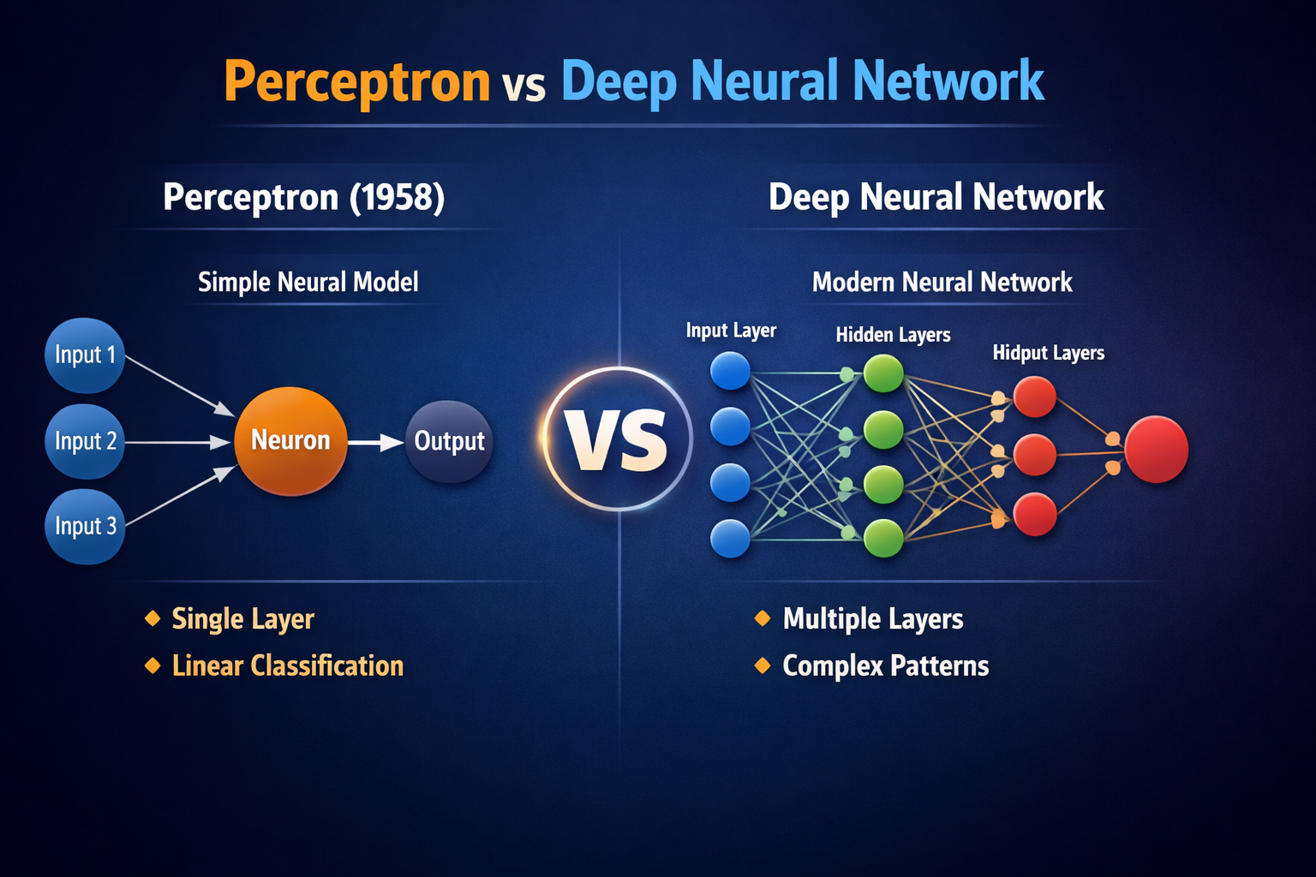
NEURAL NETWORKS, PERCEPTRON & DEEP LEARNING
Dr Ashok Gopalakrishnan
SCIENTIST & PROFESSOR

Slide 2
NEURAL NETWORKS, PERCEPTRON & DEEP LEARNING
Teaching a toddler to identify fruits is a lot like how the perceptron learning algorithm works. You start simple: if a fruit is red, it’s an apple. But if it’s green, you’ll need to refine their understanding by adding another rule: check if the fruit is round. The toddler will learn to combine these observations and identify fruits accurately.
This process lays the groundwork for how computers “learn” and enables the development of more advanced systems like neural networks, which are central to AI and Machine Learning.
Learning the perceptron algorithm equips you with essential machine-learning skills, making you proficient in problem-solving and innovation. It opens doors to high-demand career opportunities in Artificial Intelligence, data science, and beyond, giving you a competitive edge in the fast-growing tech industry. Dive in!
In a binary classification task, the perceptron algorithm receives input data and uses a set of rules to determine which category an input belongs to. The algorithm continually tweaks its internal settings (called weights) during training to minimize errors and improve accuracy.

Slide 3
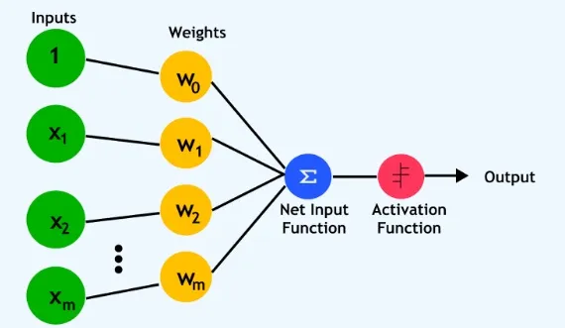
NEURAL NETWORKS, PERCEPTRON & DEEP LEARNING

Slide 4
NEURAL NETWORKS, PERCEPTRON & DEEP LEARNING
1. Input: Represents the features of the data, like the color and size of a fruit.
2. Weights: Each input feature has an associated weight, which determines its importance in making a decision. For example, if color is a more crucial factor, its weight will be higher.
3. Bias: An extra parameter is added to adjust the output along with the weighted inputs, ensuring the perceptron can make more flexible decisions.
4. Activation Function: In a perceptron, activation functions determine whether the neuron "fires" based on the weighted sum of inputs.
Perceptron models come in different types, each designed to handle varying levels of problem complexity. These range from simple single-layer structures to more advanced multi-layer models that can tackle intricate tasks. Here's a closer look at these models and their capabilities.

Slide 5
NEURAL NETWORKS, PERCEPTRON & DEEP LEARNING
A Perceptron is the simplest form of an artificial neural network, introduced by Frank Rosenblatt in 1957. It is primarily used for binary classification and serves as the foundational building block for more complex deep learning architectures like Multi-Layer Perceptrons (MLPs).
Think of a perceptron as a tiny decision‑maker. It looks at several inputs (like test scores, age, or height), gives each one a bit of importance (called a weight), adds them up, and then decides “yes” or “no.”
(Imagine a teacher deciding if a student passes — checking attendance, homework, and exam marks. Each factor has a different importance. The teacher combines them and says “Pass” or “Fail.” That’s exactly what a perceptron does — only with math instead of intuition)
Applications
Simple binary classification (spam detection, quality checks)
Logic gate modeling (AND, OR, NAND)
Educational tool for neural network fundamentals

Slide 6
NEURAL NETWORKS, PERCEPTRON & DEEP LEARNING
import numpy as np
class Perceptron:
def __init__(self, lr=0.1, epochs=20):
self.lr = lr
self.epochs = epochs
def fit(self, X, y):
self.weights = np.zeros(X.shape[1])
self.bias = 0
for _ in range(self.epochs):
for xi, target in zip(X, y):
y_pred = self.predict(xi)
update = self.lr * (target - y_pred)
self.weights += update * xi
self.bias += update
def predict(self, X):
linear_output = np.dot(X, self.weights) + self.bias
return np.where(linear_output >= 0, 1, 0)
# Example: OR Gate
X = np.array([[0,0],[0,1],[1,0],[1,1]])
y = np.array([0,1,1,1])
p = Perceptron()
p.fit(X, y)
print("Predictions:", p.predict(X))
PYTHON SNIPPET FOR PERCEPTRON

Slide 7
NEURAL NETWORKS, PERCEPTRON & DEEP LEARNING
Limitations
Works only for linearly separable data
Binary output only without modifications
No hidden layers → limited learning capacity
In deep learning, perceptrons are rarely used alone but form the conceptual basis for modern neural networks.
Think of a perceptron as a basic unit of a neural network. It takes some input, applies a mathematical calculation, and then gives an output. This process helps a model learn to classify data, making it useful for tasks like recognizing patterns and making predictions. It’s like a tiny brain cell in a neural network, helping machines learn and make predictions!
If we replace the weights and bias with common algebraic letters:
w1​ → A
w2​ → B
b → C
x1​ → X
x2​ → Y
The perceptron follows a simple mathematical equation:
z=w1​x1​+w2​x2​+b
Then, the equation simplifies to: AX+BY+C=0, This equation represents a straight line in a 2D plane.

Slide 8
NEURAL NETWORKS, PERCEPTRON & DEEP LEARNING
How Does This Help in Deep Learning?
The perceptron creates a decision boundary, which means it draws a line that separates different groups of data points.
For example, if we are classifying red dots and blue dots, the perceptron will find the best line that separates them.
Any new data point that appears on one side of the line will belong to one category, while data on the other side belongs to another.
In a Perceptron, the activation function plays a key role in deciding the output. It determines whether the perceptron should “activate” or stay inactive based on the computed value z.
Here’s how it works:
If AX + BY + C > 0, the perceptron outputs YES (1).
If AX + BY + C < 0, the perceptron outputs NO (0).
This means that the perceptron splits the space into two regions using a decision boundary (a straight line in 2D). Data points on one side of the line are classified into one category, while data on the other side belongs to a different category.

Slide 9
NEURAL NETWORKS, PERCEPTRON & DEEP LEARNING
The biggest limitation of a perceptron is that it only works well when the data is linearly separable. In simple terms, if the data points can be separated using a straight line, the perceptron can classify them correctly. However, if the data is arranged in a non-linear pattern, the perceptron fails because it can only create a straight decision boundary.
Why Does This Happen?
A Single Layer Perceptron (SLP) makes decisions based on a linear function:
y=f(∑wi​xi​+b)
This equation represents a hyperplane — a straight line in 2D, a plane in 3D, and so on. Since the perceptron’s decision-making is based on this linear function, it cannot handle complex patterns where a straight line is not enough to separate different categories.
How to Solve This Problem?
To handle non-linear data, we need more advanced models like the Multi-Layer Perceptron (MLP). These models:
Have multiple layers (input layer, hidden layers, and output layer).
Use powerful activation functions like ReLU, Sigmoid, and Tanh, which allow the network to learn complex patterns. By stacking multiple perceptrons together and introducing non-linearity, deep learning models can solve much more complex classification problems, such as image recognition, speech processing, and language translation

Slide 10
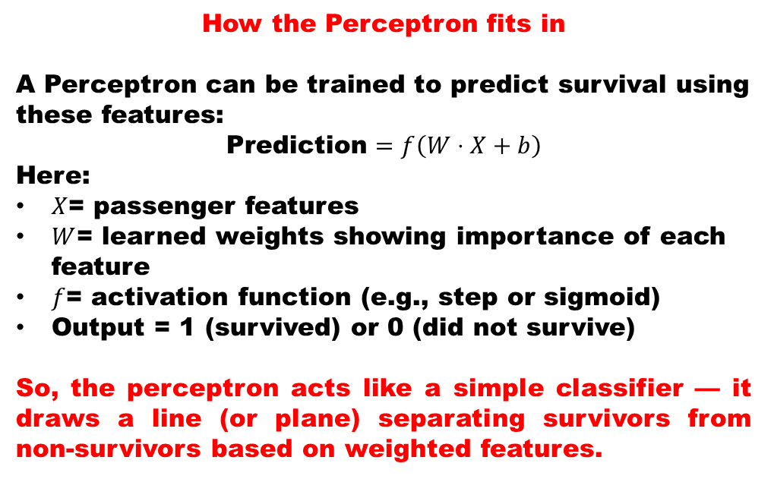
NEURAL NETWORKS, PERCEPTRON & DEEP LEARNING
Perceptron and the Titanic Problem — The Connection
What the Titanic dataset represents?
Each passenger record has features like:
Age
Gender
Ticket class
Fare
Family size
and a label: Survived (1) or Did not survive (0).
How the Perceptron fits in
A Perceptron can be trained to predict survival using these features:
$$\text{Prediction}=f\left(W⋅X+b\right)$$
Here:
$X$= passenger features
$W$= learned weights showing importance of each feature
$f$= activation function (e.g., step or sigmoid)
Output = 1 (survived) or 0 (did not survive)
So, the perceptron acts like a simple classifier — it draws a line (or plane) separating survivors from non‑survivors based on weighted features.
Why Deep Learning improves it
A single perceptron can only handle linear separations. But survival chances depend on non‑linear interactions — for example, young females in first class had higher survival odds than older males in third class. A Deep Neural Network captures these complex patterns through multiple hidden layers.
“The perceptron is like a single teacher deciding pass/fail from a few marks. A deep network is like a panel of teachers — each layer refines the decision using different perspectives.”

Slide 11
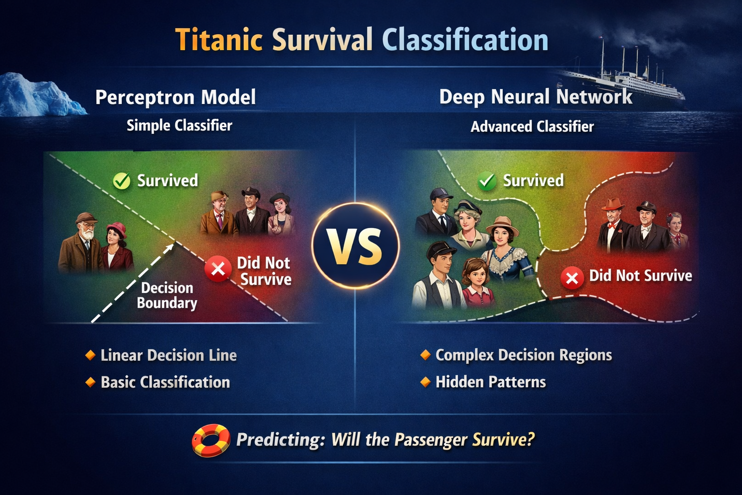
NEURAL NETWORKS, PERCEPTRON & DEEP LEARNING
Left side (Perceptron Model):
Shows a straight decision boundary.
Passengers classified with a simple “yes/no” rule.
Works only for basic, linear separations.
Right side (Deep Neural Network):
Shows curved, irregular boundaries.
Captures complex interactions (e.g., age + class + gender).
Reveals hidden survival patterns beyond simple rules.

Slide 12
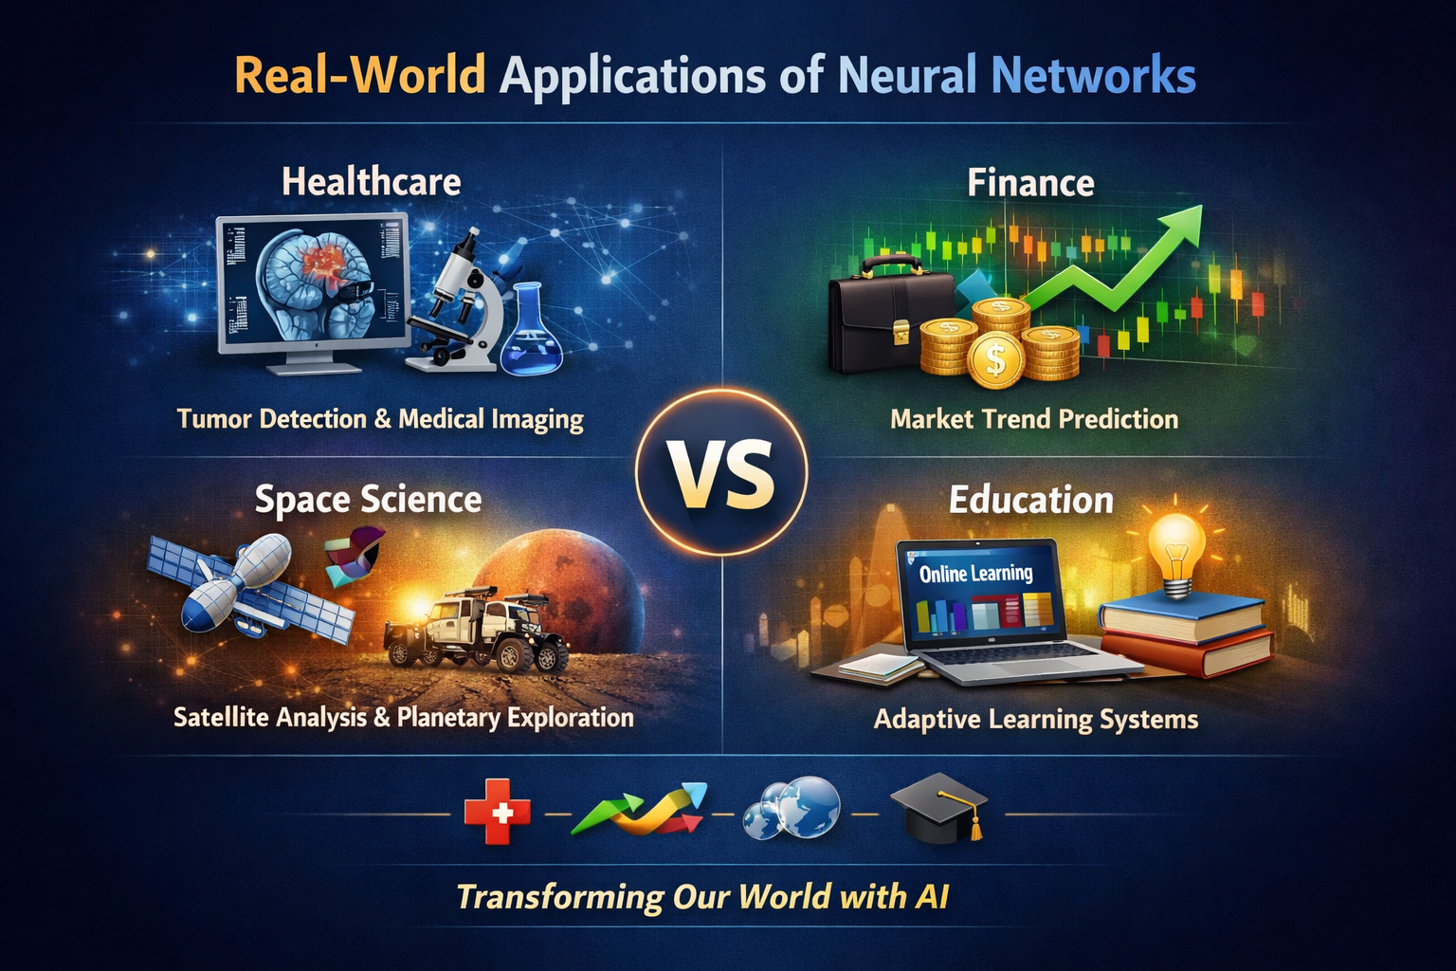
NEURAL NETWORKS, PERCEPTRON & DEEP LEARNING
Slide Overview:
Healthcare: Tumor detection and medical imaging.
Finance: Market trend prediction and fraud detection.
Space Science: Satellite analysis and planetary exploration.
Education: Adaptive learning systems and personalized tutoring.

Slide 13
NEURAL NETWORKS, PERCEPTRON & DEEP LEARNING
Deep Learning — The Brain of Modern AI
Deep Learning is a branch of Machine Learning that uses neural networks with many hidden layers to learn complex patterns from large amounts of data. Each layer transforms the input slightly, helping the network discover subtle relationships — much like how our brain processes vision, sound, and language.
Why “Deep”?
Because it has many layers — each layer adds depth to understanding. A shallow network might only see simple patterns; a deep one can recognize faces, translate languages, or predict survival on the Titanic.
Imagine peeling an onion — each layer reveals more detail. Deep Learning peels data layer by layer until it understands the full picture.”
Input Layer: Receives raw data (images, text, numbers).
Hidden Layers: Extract features step by step — edges → shapes → objects in an image, or letters → words → meaning in text.
Output Layer: Produces predictions or classifications.

Slide 14
NEURAL NETWORKS, PERCEPTRON & DEEP LEARNING
Applications of Deep Learning
Domain | Example
🩺 Healthcare | Detecting tumors in MRI scans
💰 Finance | Fraud detection and stock prediction
🚀 Space Science | Analyzing satellite imagery
🎓 Education | Personalized learning systems
🗣️ Language | Chatbots and translation tools

Slide 15
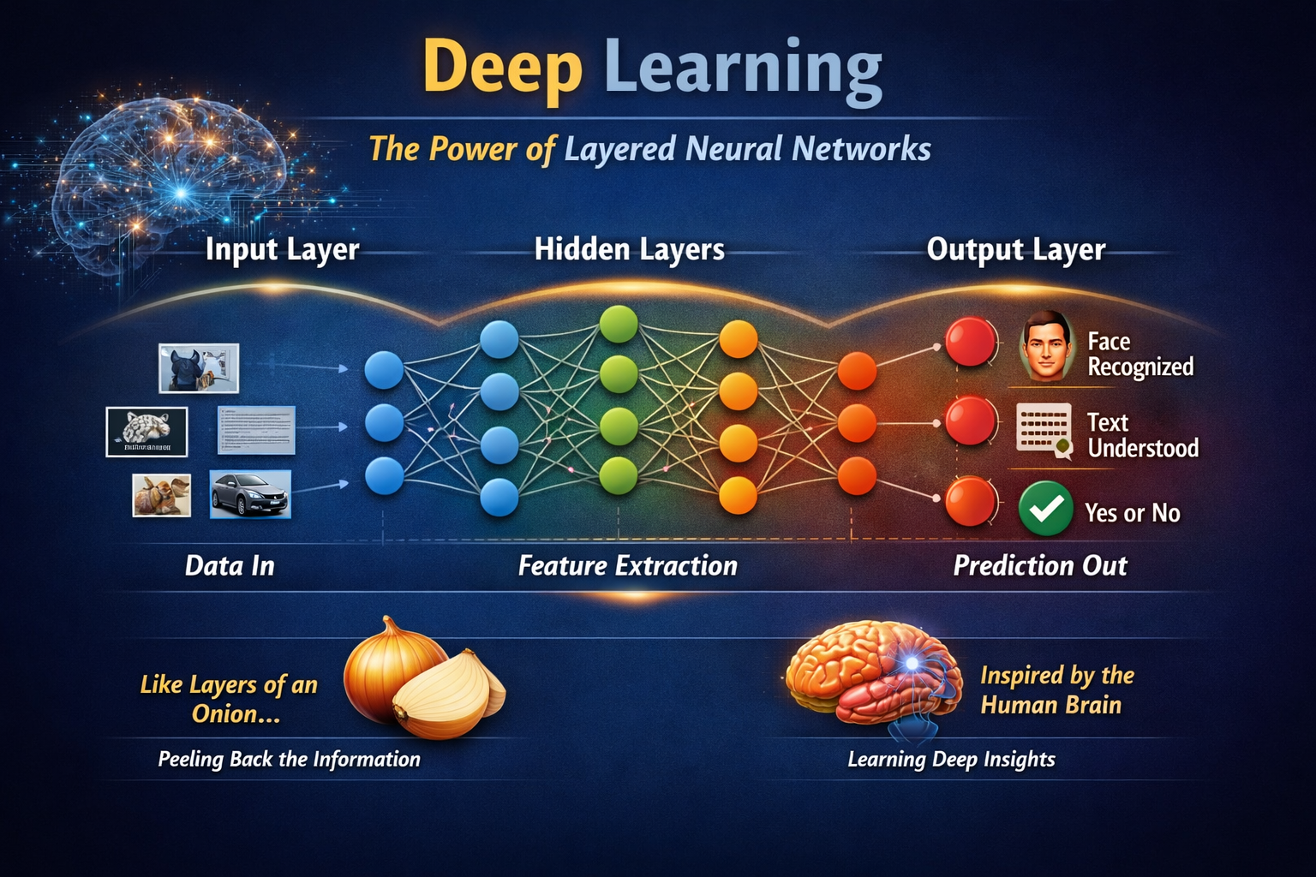
NEURAL NETWORKS, PERCEPTRON & DEEP LEARNING
Analogies:
Like layers of an onion → peeling back information.
Inspired by the human brain → learning deep insights.

Slide 16
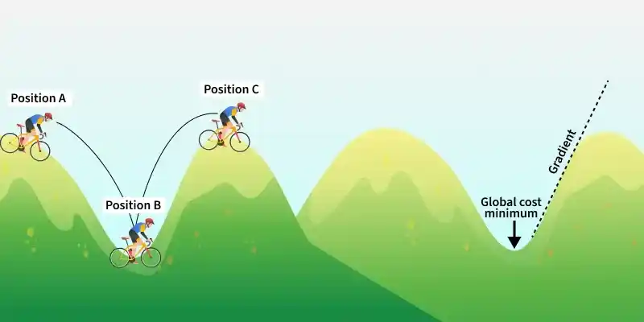
NEURAL NETWORKS, PERCEPTRON & DEEP LEARNING
Gradient Descent Algorithm in Machine Learning
Gradient Descent is an optimization algorithm used to minimize the error of a machine learning model by updating parameters in the direction of decreasing loss.
Minimizes the loss or error of a model
Updates parameters step by step using gradients
Helps models like neural networks and regression learn optimal weights
“Imagine hiking down a mountain blindfolded — you feel the slope (gradient) under your feet and take small steps downhill until you reach the valley (minimum error).”

Slide 17
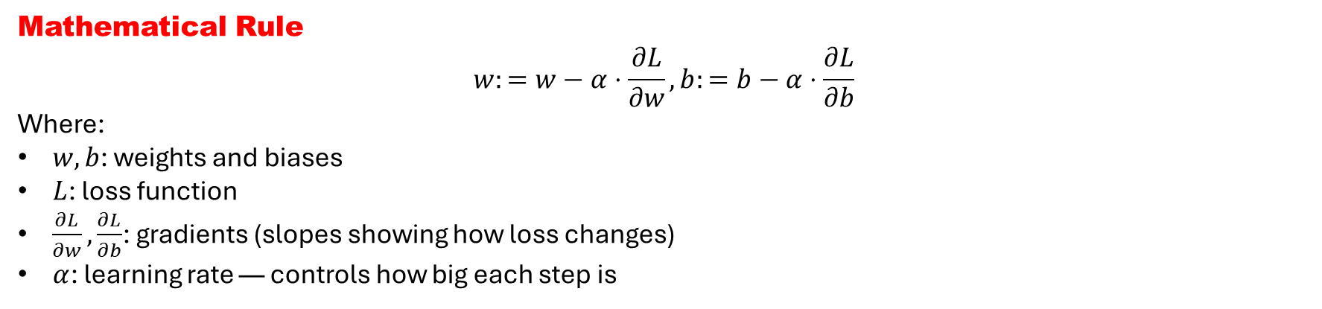
NEURAL NETWORKS, PERCEPTRON & DEEP LEARNING
Gradient Descent Algorithm in Machine Learning
Mathematical Rule
$$w:=w−α⋅\frac{∂L}{∂w}, b:=b−α⋅\frac{∂L}{∂b}$$
Where:
$w,b$: weights and biases
$L$: loss function
$\frac{∂L}{∂w},\frac{∂L}{∂b}$: gradients (slopes showing how loss changes)
$α$: learning rate — controls how big each step is
How It Works in Deep Learning
Each layer computes its output and error.
Backpropagation calculates gradients for all weights.
Gradient Descent updates each weight slightly to reduce the overall error.
Repeating this process across many epochs gradually improves predictions.

Slide 18
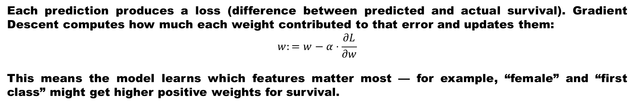
NEURAL NETWORKS, PERCEPTRON & DEEP LEARNING
Gradient Descent Algorithm in Machine Learning
In Neural Networks
Gradient Descent + Backpropagation = Learning Together, they enable the network to adjust millions of parameters efficiently, discovering patterns in images, text, or data.
In the Titanic dataset, your model tries to predict whether a passenger survived (1) or not (0) based on features like:
Age
Gender
Ticket class
Fare
Family size
Initially, the network guesses randomly — its weights are untrained. Gradient Descent then adjusts these weights to reduce the prediction error.
Each prediction produces a loss (difference between predicted and actual survival). Gradient Descent computes how much each weight contributed to that error and updates them:
$$w:=w−α⋅\frac{∂L}{∂w}$$
This means the model learns which features matter most — for example, “female” and “first class” might get higher positive weights for survival.

Slide 19
NEURAL NETWORKS, PERCEPTRON & DEEP LEARNING
Gradient Descent Algorithm in Machine Learning
In the Titanic Context
Early epochs: The model misclassifies many passengers.
Later epochs: After repeated Gradient Descent updates, the loss decreases.
Result: The network learns survival patterns — age, gender, and class interactions — just like a human learning from feedback.
“Imagine the model as a sailor steering toward the safest route. Gradient Descent is the compass — it tells the sailor which direction reduces risk (error) and guides the ship toward the correct prediction.”

Slide 20
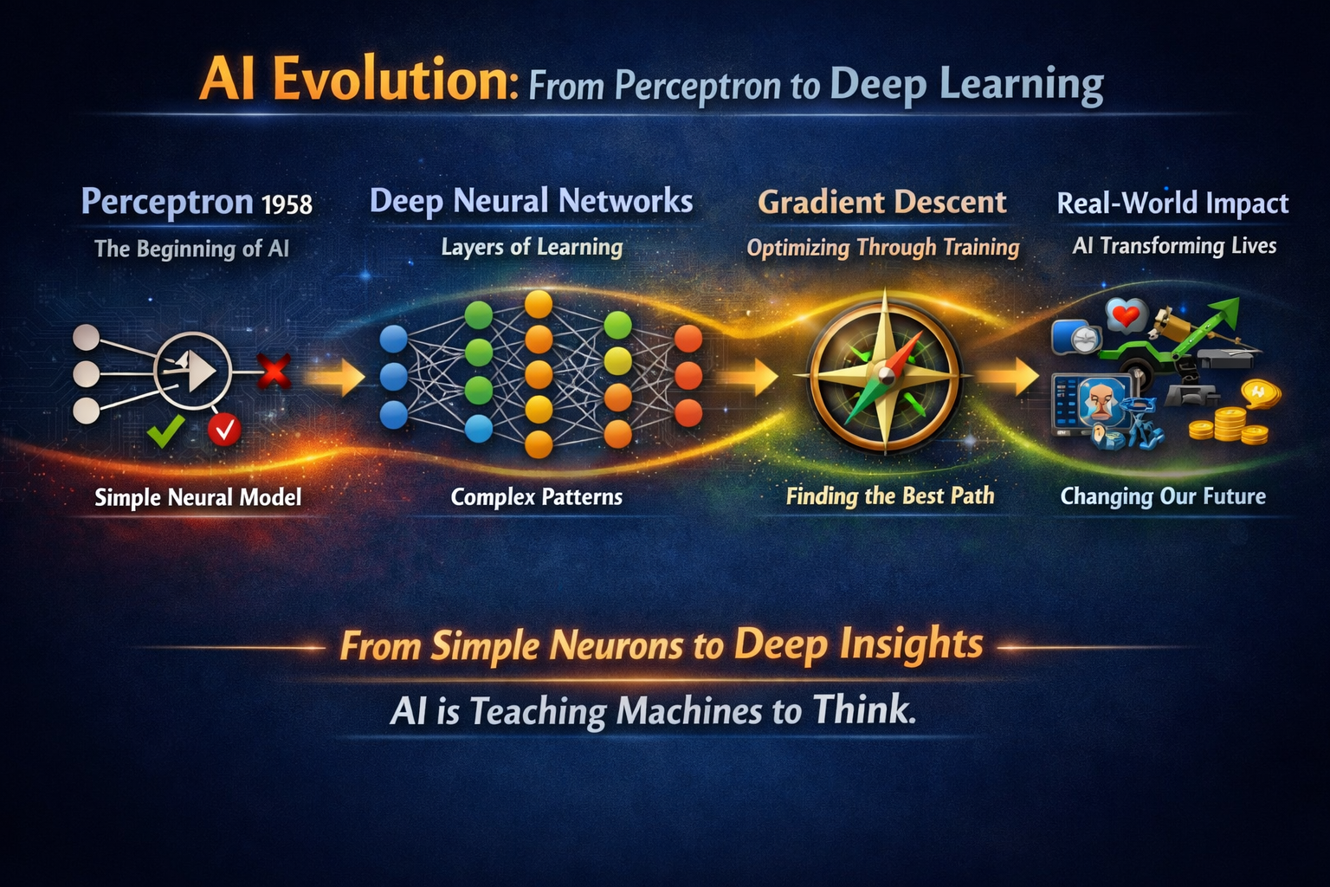
NEURAL NETWORKS, PERCEPTRON & DEEP LEARNING
Gradient Descent Algorithm in Machine Learning
Perceptron (1958): The beginning of AI — simple neural model.
Deep Neural Networks: Layers of learning — complex patterns.
Gradient Descent: Optimizing through training — finding the best path.
Real‑World Impact: AI transforming lives — healthcare, finance, space science, education.
“From simple neurons to deep insights — AI is teaching machines to think.”

Slide 21
NEURAL NETWORKS, PERCEPTRON & DEEP LEARNING
Worksheet: Understanding Neural Networks and Deep Learning
Part C — Real‑World Applications
Match each domain with its neural‑network use case:
Part A — Concept Review
Define Perceptron in your own words.
List three key differences between a Perceptron and a Deep Neural Network.
Explain what Gradient Descent does in a neural network.
Why is backpropagation essential for learning?
Part B — Titanic Survival Case Study
Identify five features used to predict survival in the Titanic dataset.
Describe how Gradient Descent helps the model improve its predictions.
What patterns might the network learn about survival?
Sketch a simple diagram showing how data flows through layers.
Domain | Application
Healthcare | Tumor detection
Finance | Market trend prediction
Space Science | Satellite image analysis
Education | Adaptive learning systems
Part D — Think & Reflect
“From simple neurons to deep insights — AI is teaching machines to think.”
Write a short paragraph (5–6 lines) on what this statement means to you.

Slide 22
NEURAL NETWORKS, PERCEPTRON & DEEP LEARNING
Today’s session traced the remarkable journey of neural networks — from the humble Perceptron, which could only draw simple linear boundaries, to the sophistication of Deep Learning, where multiple hidden layers uncover complex, non‑linear patterns. Using the Titanic survival dataset, we saw how these models evolve from basic classification to powerful prediction, revealing how mathematics and computation can capture human‑like decision making.
We then explored the role of Gradient Descent, the true learning engine of deep networks. Just as a sailor uses a compass to steer toward safety, Gradient Descent guides the network step by step toward lower error, refining its weights until accurate predictions emerge. This process transforms raw passenger data into meaningful insights, demonstrating how algorithms learn from mistakes and improve with experience.
As we conclude, the broader impact of these concepts became clear: neural networks are not just academic constructs, but tools reshaping healthcare, finance, space science, and education. From predicting survival on the Titanic to detecting tumors or guiding planetary exploration, the same principles drive innovation across disciplines. The message is simple yet profound — from simple neurons to deep insights, AI is teaching machines to think, and empowering us to re‑imagine the future.

Slide 23

NEURAL NETWORKS, PERCEPTRON & DEEP LEARNING

Slide 24


